Slide 1

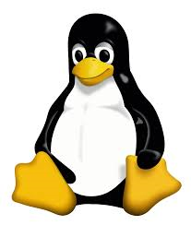
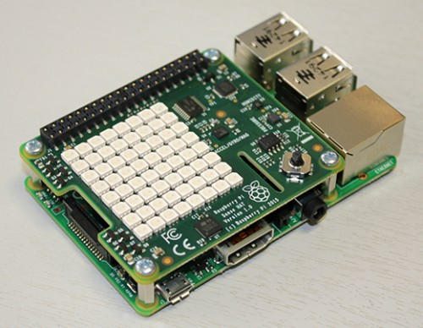

EG206 Semestral Project IV
Launch
Introduction to Raspberry PI Setup

Slide 2

Outline
Setup
Remote Access
Login to RaspberryPi

Slide 3
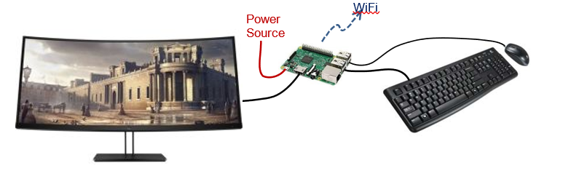
Standalone Setup
The RPi can be set up as a standalone computer by connecting a monitor, keyboard and mouse through its various interfaces.
Standalone Setup

Slide 4
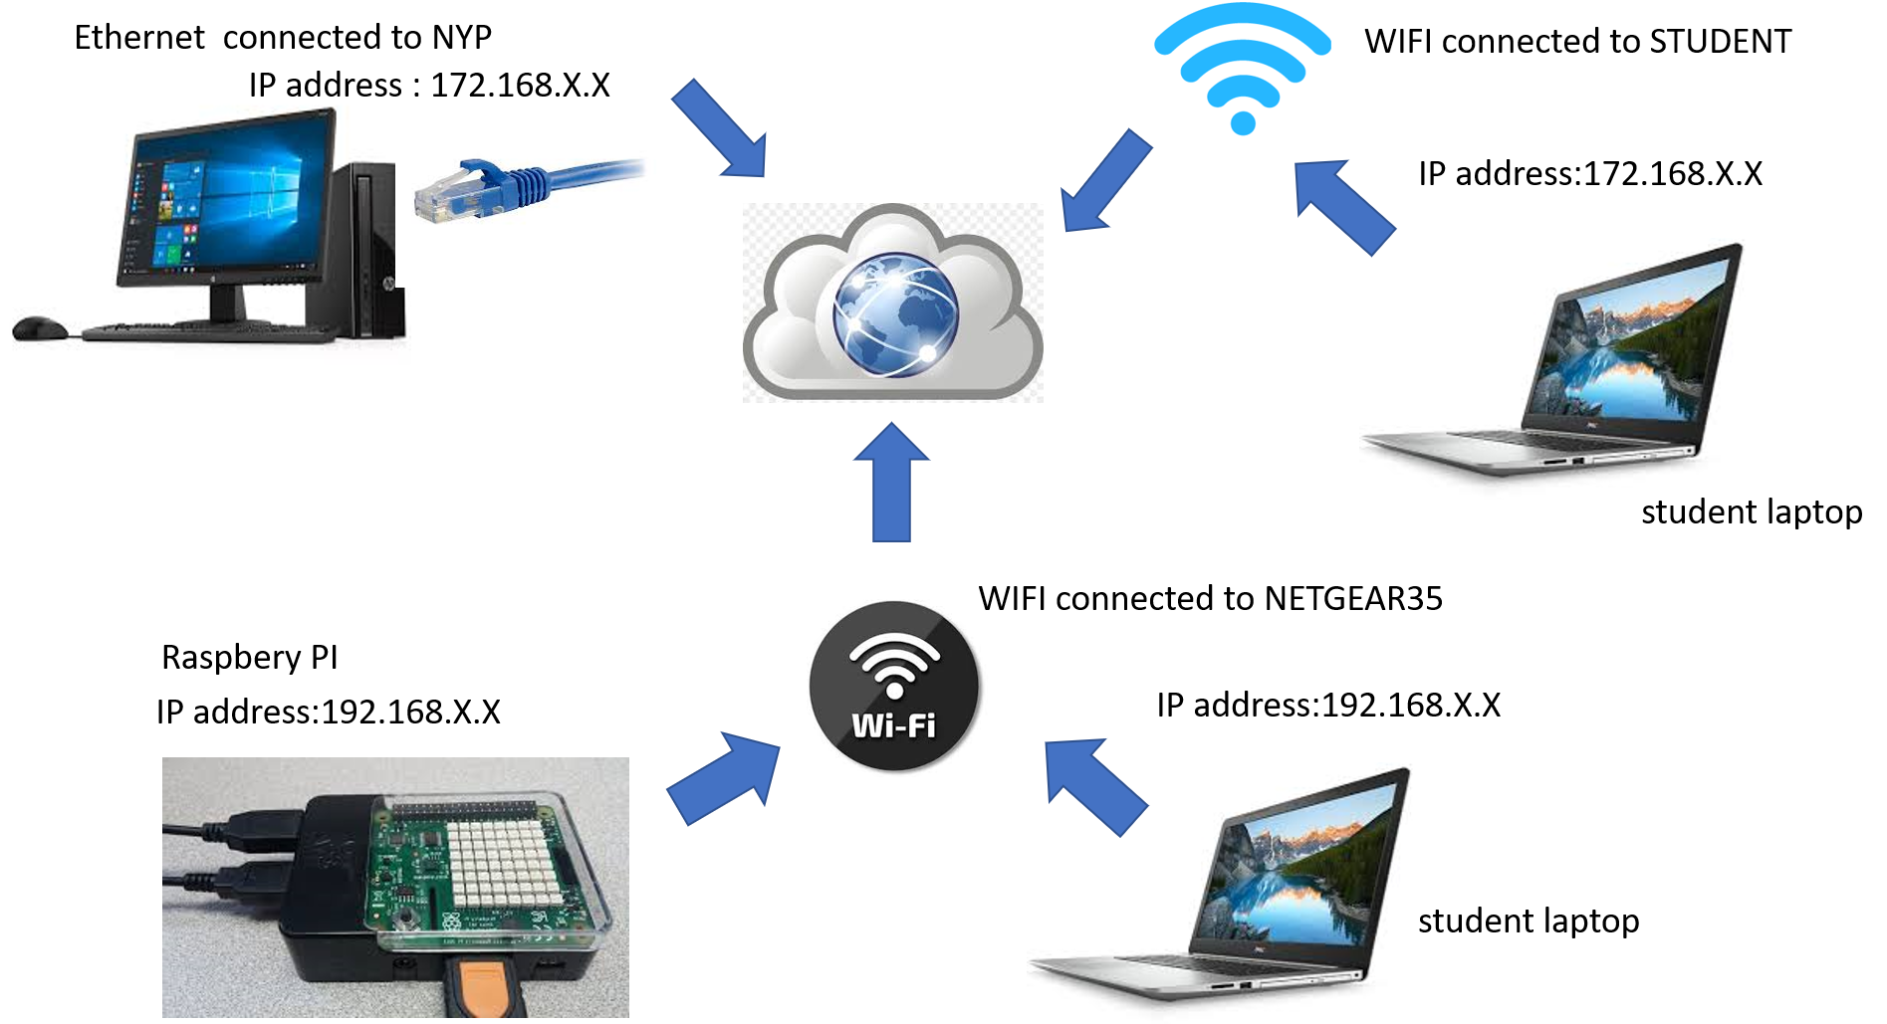
Ethernet/Wifi Connection

Slide 5
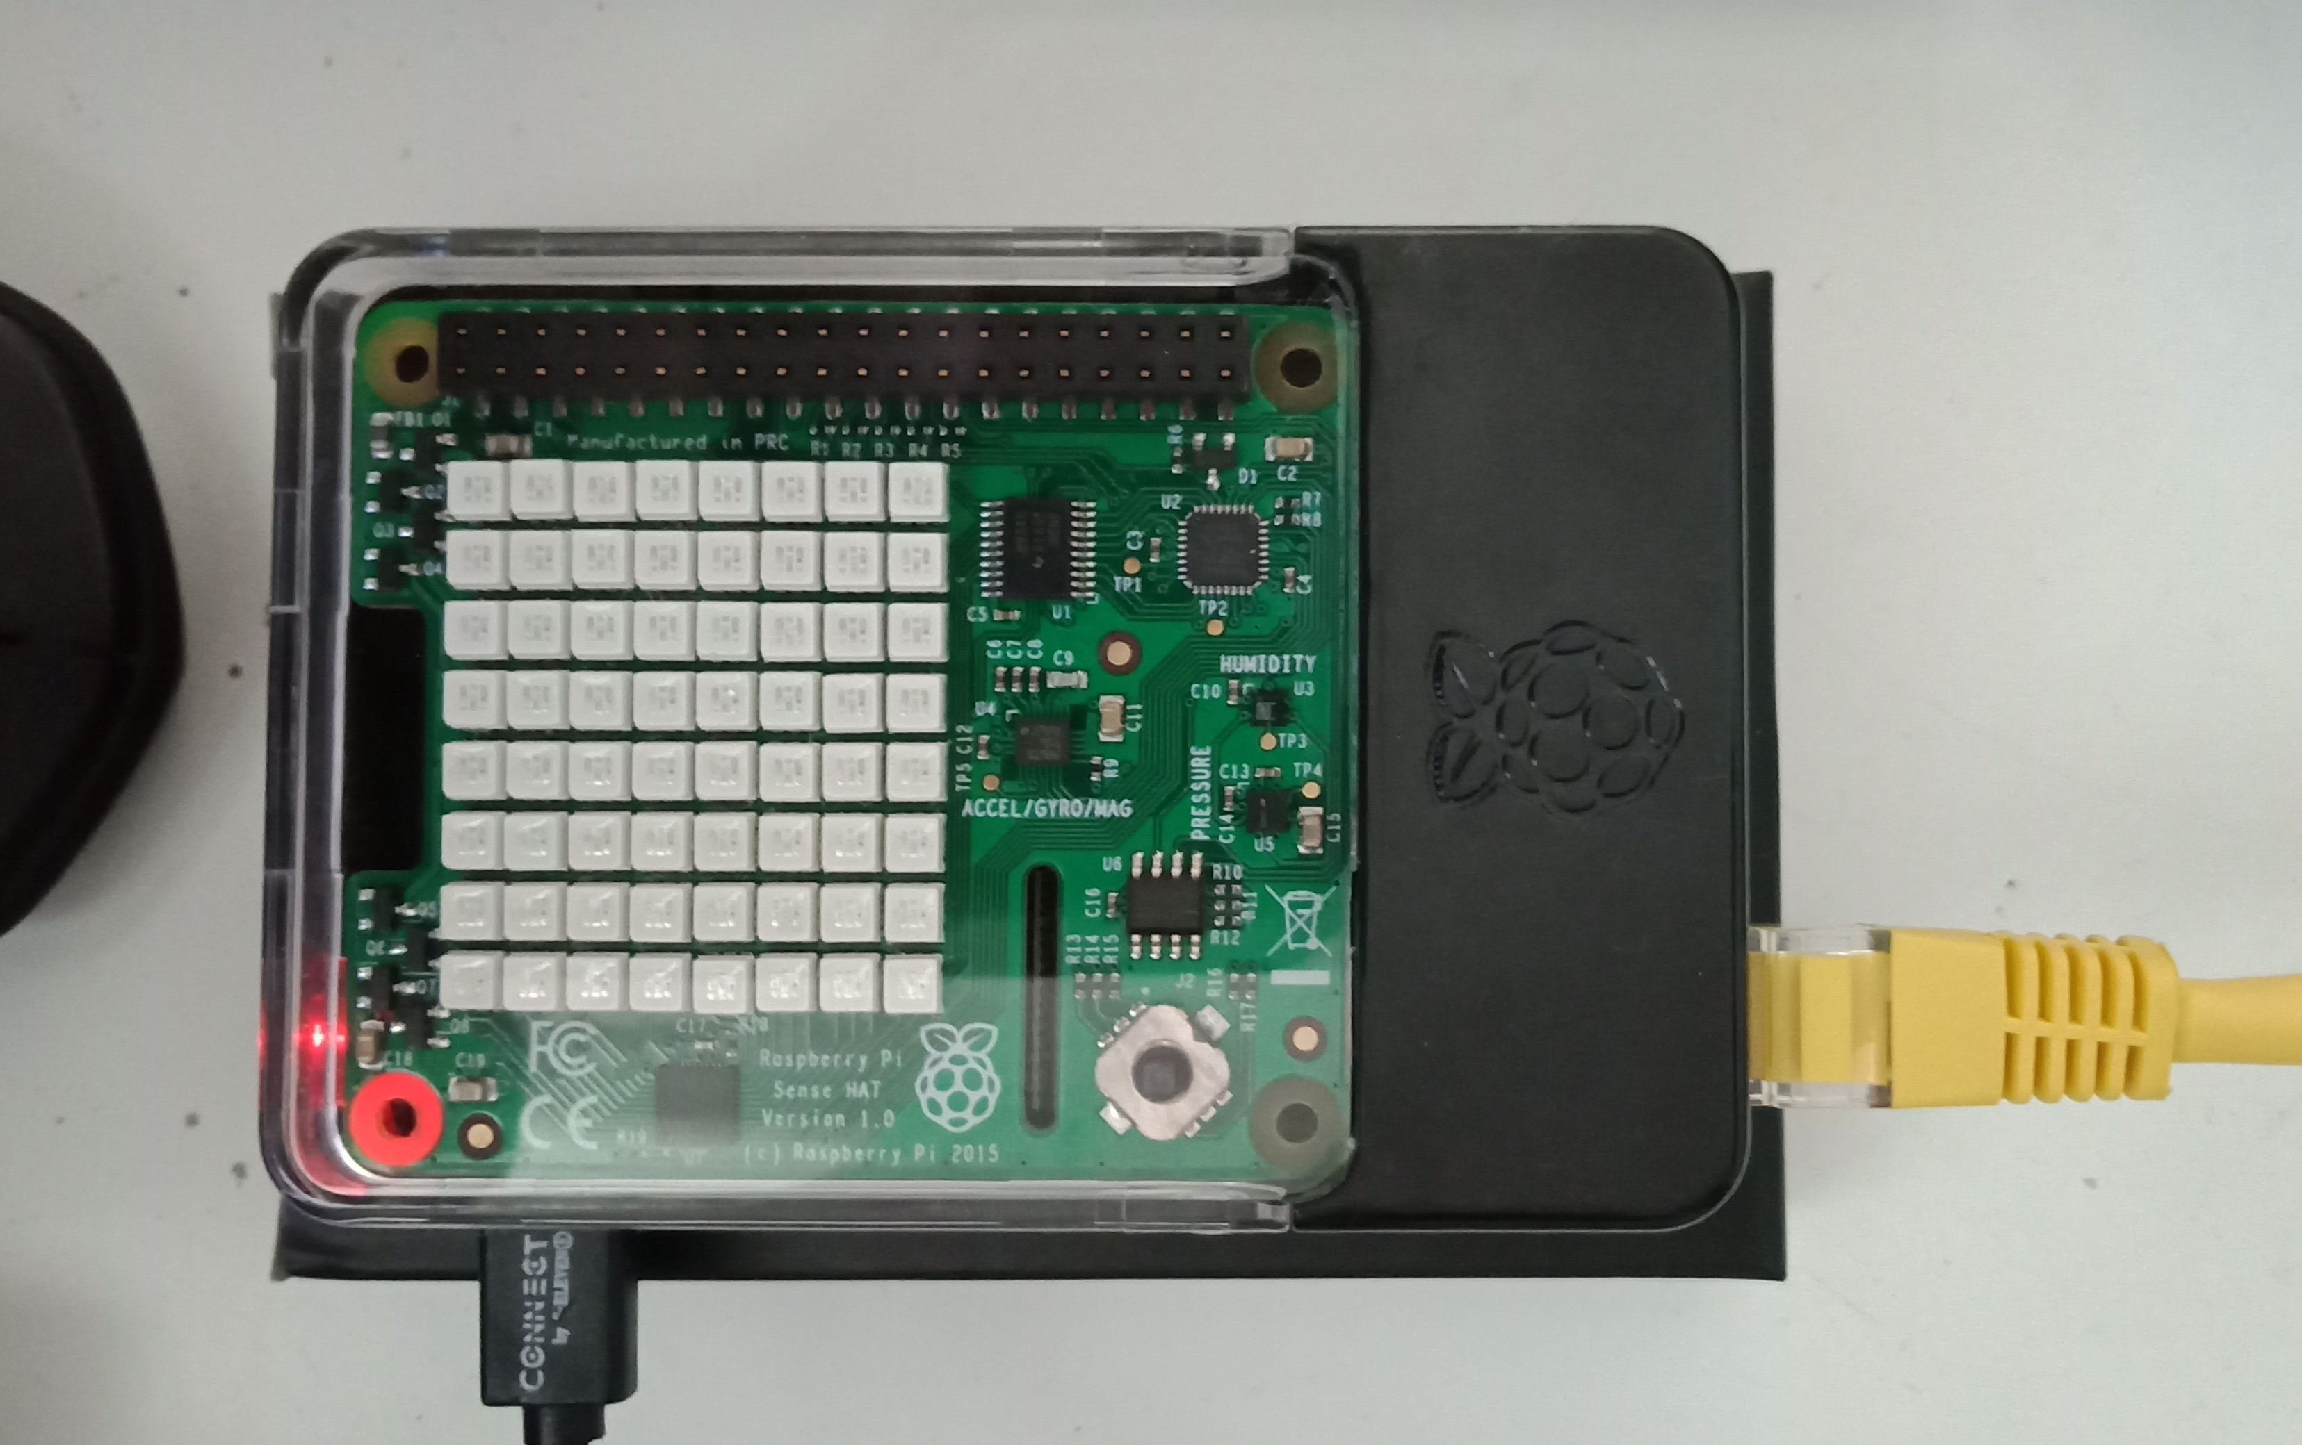
RaspberryPi - senseHat
As an educational kit, you can add other devices to the RPi board, typically in the form of add-on modules. In this exercise, you will be using the Sense Hat add-on module on the RPi board, such that you can code programs to display messages and images on the module.
RaspberryPi senseHat

Slide 6
Before we start
Let’s download the required software on top your laptop

Slide 7



Require Software on Your Laptop
Raspberry Pi
https://www.realvnc.com/en/connect/download/viewer/

Slide 8
Getting a Terminal on Your Raspberry Pi

Slide 9
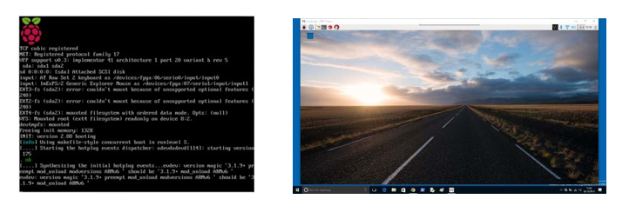
Familiarization of the RPi User Interface and its common commands
You will now go through a sequence of tasks designed to get you familiarized with the operation of the RPi, in particular, certain commands that are frequently used on RPi.
You will see you will see a series of messages appearing on the monitor, which eventually leads to the a graphic based display screen – the Desktop screen
connect the USB cable to one of the USB port desktop PC in the lab)
Apply the power source to the Rpi

Slide 10
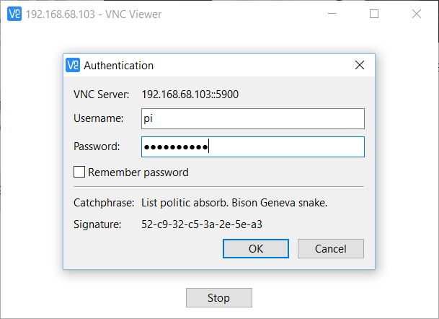
Raspbian Desktop – Access thru VNC
Enter Username : raspi
Password:raspberry

Slide 11
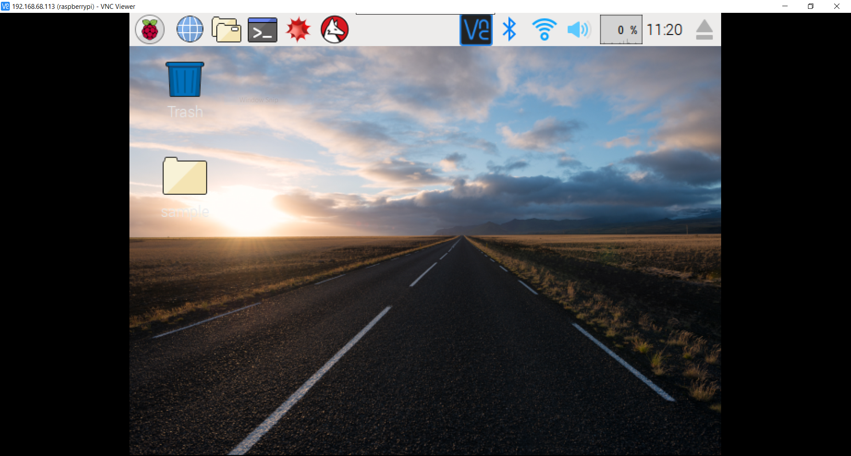
Raspbian Desktop – Access thru VNC

Slide 12
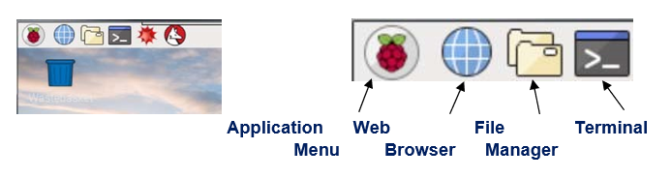
Raspbian Desktop – Menu Bar
•
•
Click on the Application Menu icon - you will be provided with a list of options - programs and functions available on RPi. Note that there is a Shutdown function which is used to properly turn off the RPi at the end of the exercise.
Click on the Application Menu icon - you will be provided with a list of options - programs and functions available on RPi. Note that there is a Shutdown function which is used to properly turn off the RPi at the end of the exercise.
Terminal is a program that is usually used to enter text commands and run other programs, as will be seen later.
The Web Browser is normally used for surfing internet
File Manager is used to explore the directories and files stores on the RPi.

Slide 13
Raspbian Desktop – File Manager
•
•
Click on the File Manager icon. You will be presented with a window showing the various directories/folders and files available on the RaspberryPi
Click on the EGR206 folder

